Slide 1
FOOD AND DRINK
Starter

Slide 2
FRUIT

Slide 3

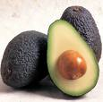
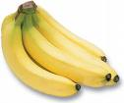


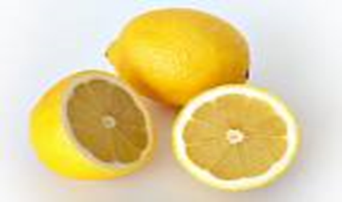
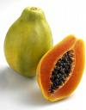


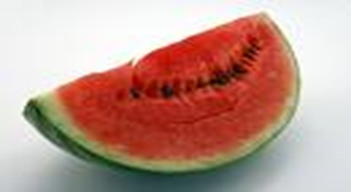
strawberry
Avocado
Banana
Grapes
Orange
Lemon
Papaya
Pineapple
Apple
Watermelon

Slide 4
VEGETABLES

Slide 5
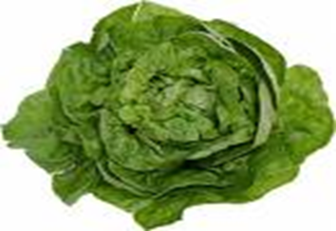
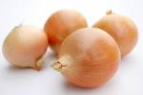

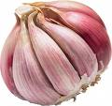

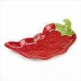
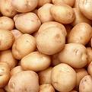

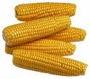


Lettuce
Carrot
Onion
Garlic
Cucumber
Pepper
Potato
Pumpkin
Corn
Tomato
Olive

Slide 6
MEAT

Slide 7
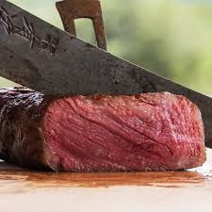

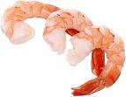
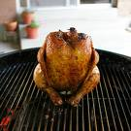

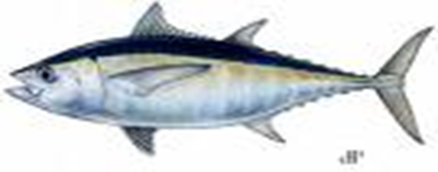
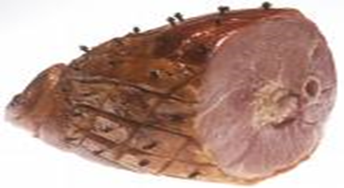
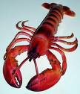
Beef / Steak
Sausage
Shrimp
Crab
Fish
Chicken
Ham
Lobster

Slide 8
DAIRY

Slide 9





Milk
Yogurt
Butter
Cheese
Cream Cheese

Slide 10
GENERAL FOOD

Slide 11
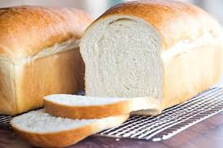
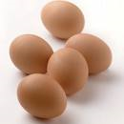

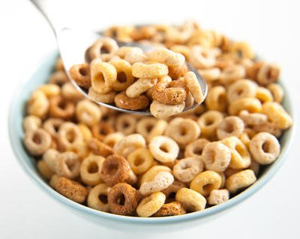


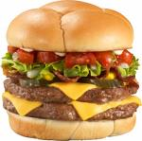
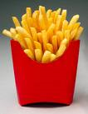
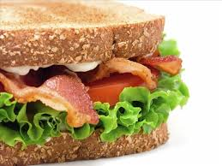
Bread
Eggs
Sugar
Cereal
Rice
Pasta
Sandwich
Burger
Fries or Chips

Slide 12
DRINK

Slide 13

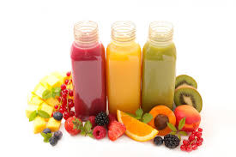


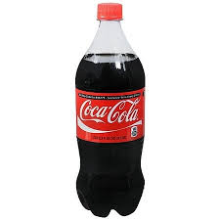


Coffee
Tea
Fruit Juice
Wine
Water (Still or Sparkling)
Soda / Pop
Beer

Slide 14
DESSERTS

Slide 15
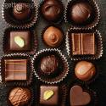

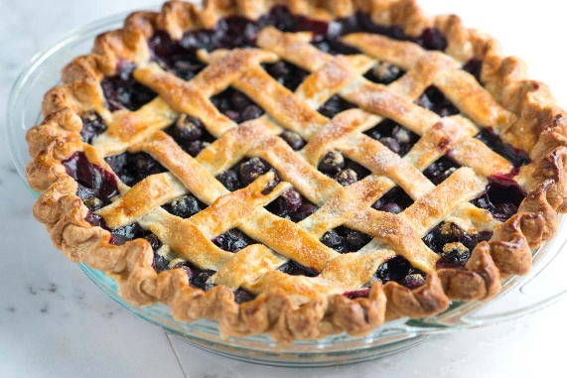
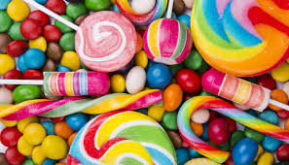

Chocolate
Cake
Candy or
Sweet
Pie
Ice Cream

